Slide 1
Open Source Platform and Network Administration
Lesson 12

Slide 3
Learning Objective
Describe vulnerabilities in Linux services and the appropriate steps to mitigate the risks.

Slide 4
Key Concepts
Commonly installed Linux services
Bastion hosts
Bastion host hardening
Disabling unneeded services and removing unneeded packages
chroot jails

Slide 5
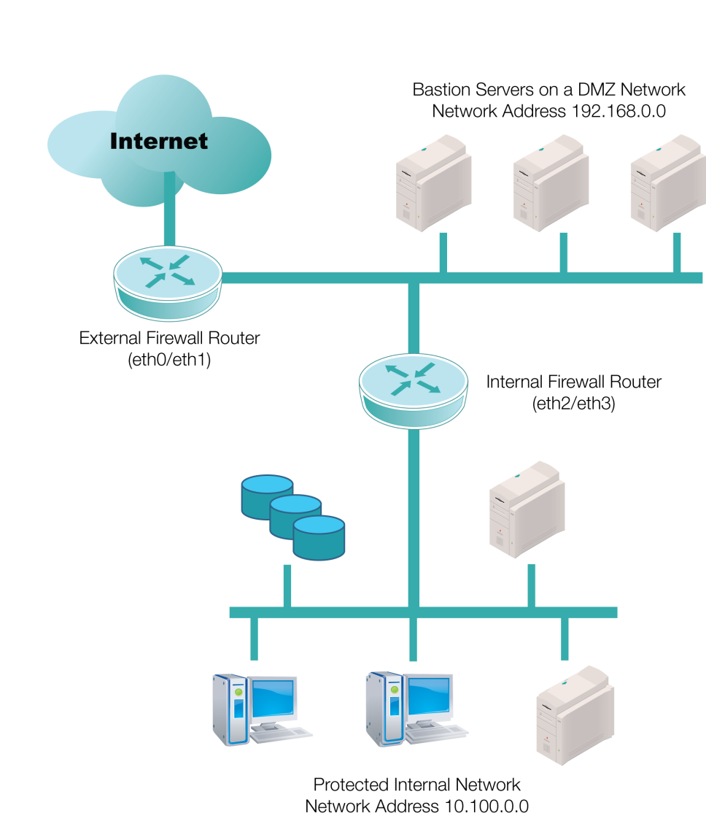
Bastion Servers in the DMZ

Slide 6

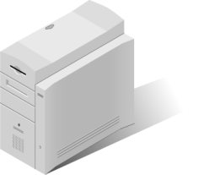
Bastion Hosts
Only has access to the one server and service
Web Server
H
Black-hat hacker exploits a bug in the Simple Mail Transfer Protocol (SMTP) Server
Database Server
Now has access to all the server services
Bastion Hosts
SMTP Server
Multipurpose Server

Slide 7
Configuring a Bastion Host
Install an administrative service like SSH
Start with minimal Linux installation
Set up at least basic IPv4 networking
Remove unnecessary services
Remove unnecessary packages
Notes:
A Graphical User Interface (GUI) requires the X Window System to run, which is an added security risk. Other users in the network cannot login to the GUI remotely when XDMCP is turned off.

Slide 8
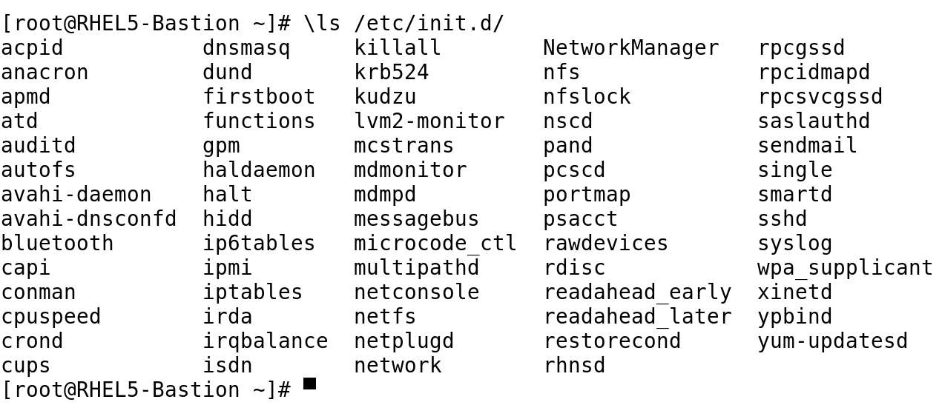
Service Scripts in /etc/init.d/

Slide 9
Vulnerabilities in Linux Services
Denial of Service (DoS)
Buffer overflows and misconfigured servers
Unpatched servers and rootkits
Web applications
Default settings and weak passwords

Slide 10
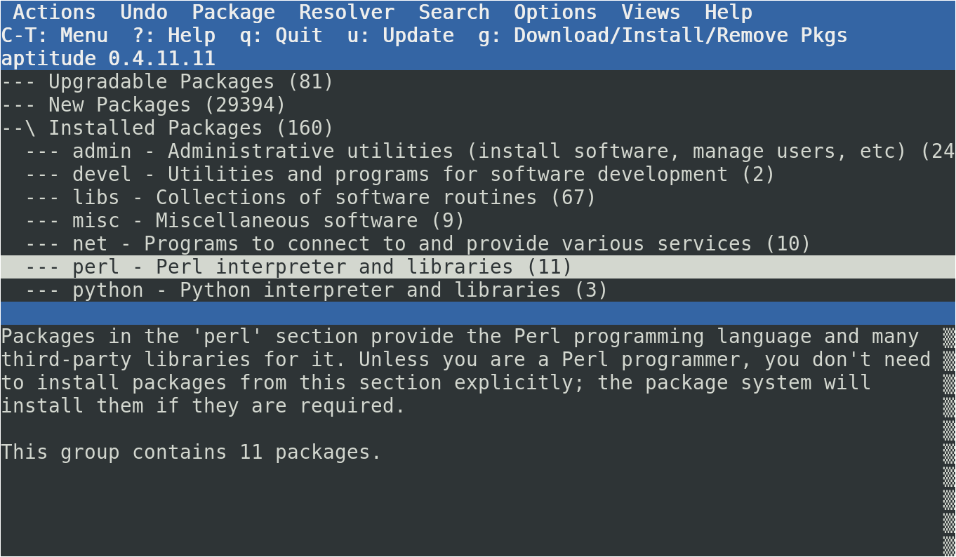
Aptitude as a Package Browser

Slide 11
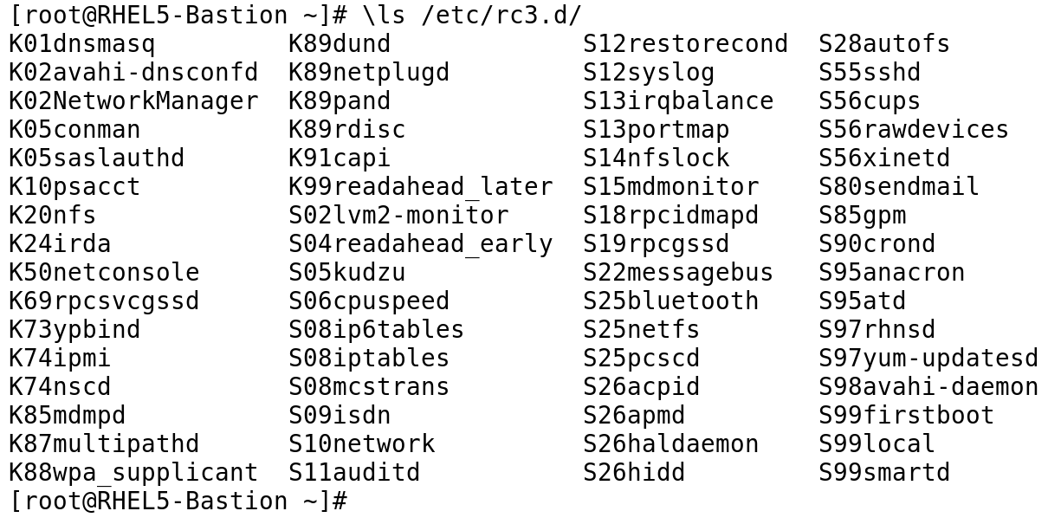
Active Services in Runlevel 3 Start with “S”
Notes:
The standard for most Linux distributions is to activate services in runlevels 2, 3, 4, and 5.
Linux distributions should be set to deactivate most services in runlevels 0, 1, and 6.

Slide 12
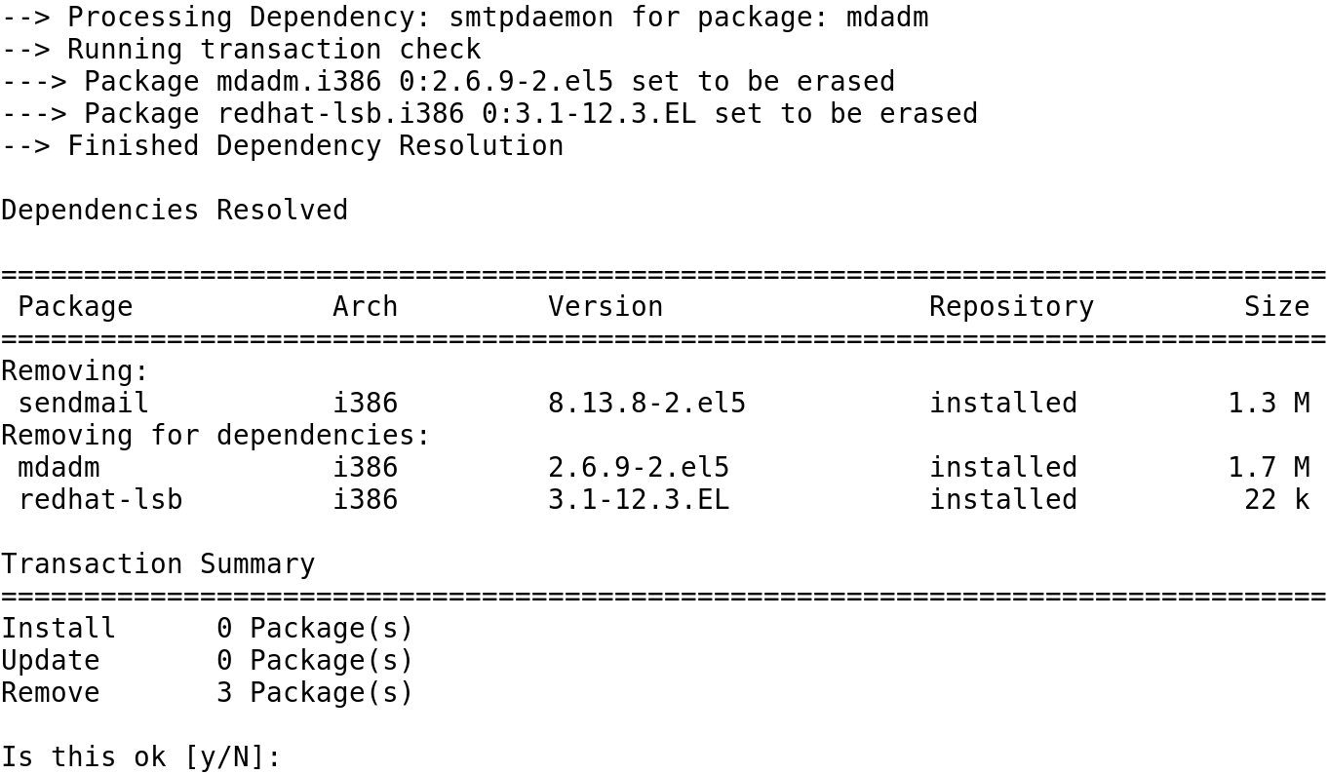
Dependency Processing
Notes:
Do you really want to uninstall packages for software RAID and the Linux Standards Base?

Slide 13
Mitigating Other Service Risks
Turn off the X Display Manager Control Protocol (XDMCP).
Keep only those productivity tools that are necessary.
Don't run any network services that are not needed.
Run the logwatch tool to monitor any attempted access to the Linux system.
Notes:
A Graphical User Interface (GUI) requires the X Window System to run, which is an added security risk. Other users in the network cannot login to the GUI remotely when XDMCP is turned off.

Slide 14
Bastions in a Virtualized Environment
Easy to create new systems
Systems can be configured with just the hardware necessary
Easy to copy configurations to create additional virtual machines
Files do not have to be large

Slide 15
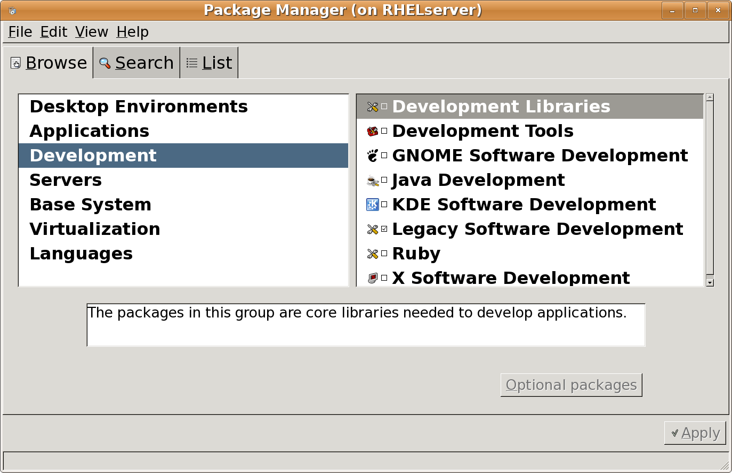
Categories of Red Hat Development Tools

Slide 16
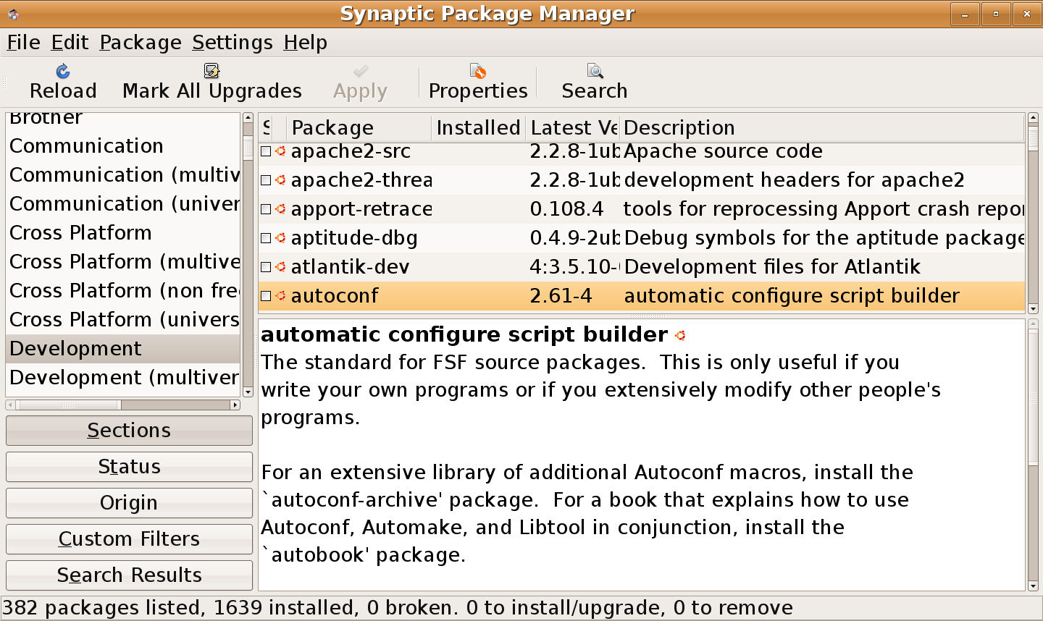
Categories of Ubuntu Development Tools

Slide 17
Benefits of Disabling or Uninstalling Unneeded Services
To eliminate the possibility of a black-hat hacker exploiting a vulnerability to a service when the service is not running
To improve system performance by running only the required services
To save hard drive space by uninstalling
To eliminate the need to update or patch a service when security vulnerabilities are discovered

Slide 18
Getting Rid of Unneeded Services
Uninstall
Use yum or apt-get
Deactivate
Stop a service
Kill a PID
Watch for dependencies
Change service defaults
Notes:
A Graphical User Interface (GUI) requires the X Window System to run, which is an added security risk. Other users in the network cannot login to the GUI remotely when XDMCP is turned off.

